Slide 1

NETFLIX [NFLX] STOCK ANALYSIS

Slide 2
EXECUTIVE SUMMARY
Distribution of the stock prices for Netflix in 2017
Summary of Netflix stock and revenue for the past four quarters
Summary of Netflix revenue versus actual earnings per share (EPS)
Netflix 2017 stock performance against the Dow Jones Industrial (market index)
Data analysis, conclusions and visualizations generated by Joseph Ashizawa. Data visualizations are designed to engage further discussion regarding the performance of NETFLIX [ticker: NFLX] against the broader market, accuracy of earnings forecasts, potential risk factors and possible earnings efficiency improvements.

Slide 3
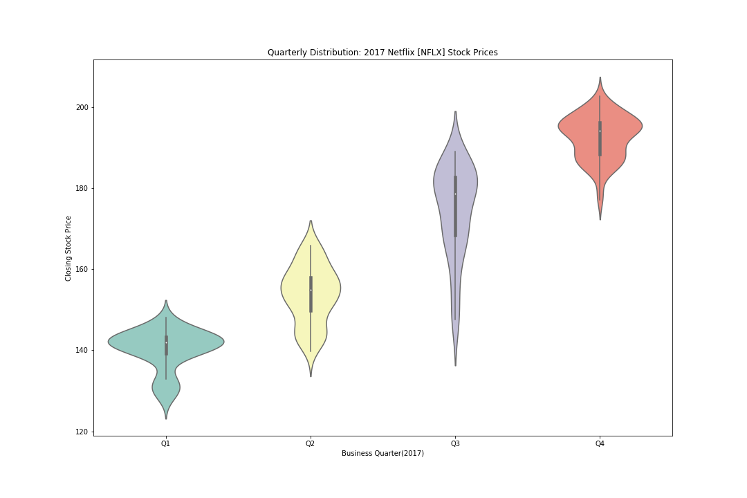
count 251.000000
mean 165.374263
std 21.295641
min 127.489998
25% 144.245002
50% 162.429993
75% 185.594994
max 202.679993
STOCK PRICE DISTRIBUTION BY QUARTER
Netflix performance over the course of 2017 was remarkably positive with a stock performance peaking in Q4 at $ 202.68 after a steady climb from a Q1 low of $ 127.49.
Netflix average stock price grew by an impressive 37.2% from Q1 2017 to Q4 2017. Price volatility peaked in Q3 after a slight rise in Q2 which diverges from the rest of the market. This movement could indicate that a significant event took place during that period. It appears investor concerns on the current valuation Netflix and future earnings potential were influenced despite EPS estimates on target for Q2.
count mean std min 25% 50% 75% max
Q1 62.0 140.309517 4.951144 127.489998 139.154998 141.889999 143.370003 148.059998
Q2 63.0 153.835556 7.052627 139.759995 149.750000 154.889999 158.025002 165.880005
Q3 63.0 174.400317 11.328460 146.169998 168.315002 178.550003 182.654999 189.080002
Q4 63.0 192.553810 5.431155 177.009995 188.344993 194.100006 196.125000 202.679993

Slide 4
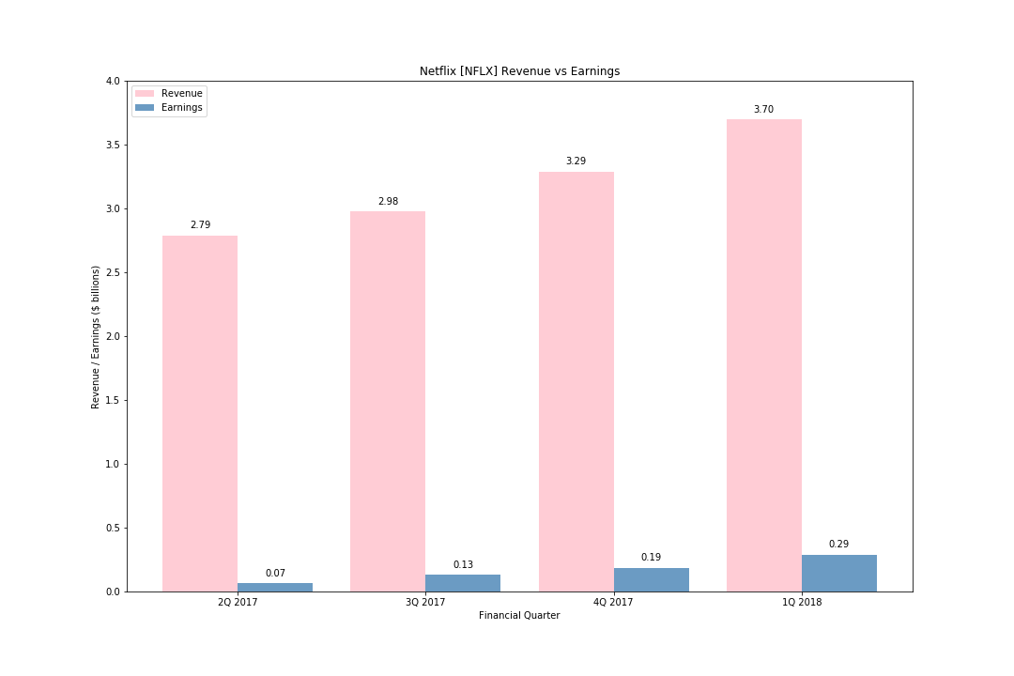
NETFLIX REVENUE VS EARNINGS
Netflix revenue climbed alongside their stock performance starting with $2.79B in Q1 to a peak in Q4 of $3.70B. Earnings also climbed from $70M in Q1 to $290M in Q4 more than quadrupling their earnings.
Earnings efficiency improved substantially over the four quarters in 2017 with earnings margins rising from 2.35% to 7.84%. This rise could imply that fixed costs are relatively stable and earnings will continue to rise alongside revenue if variable costs are kept under control and substantial capex expenses or long term liabilities are not on the horizon.
rev earn %
2.79 0.06560 2.35125
2.98 0.12959 4.34865
3.29 0.18552 5.63890
3.70 0.29012 7.84108

Slide 5
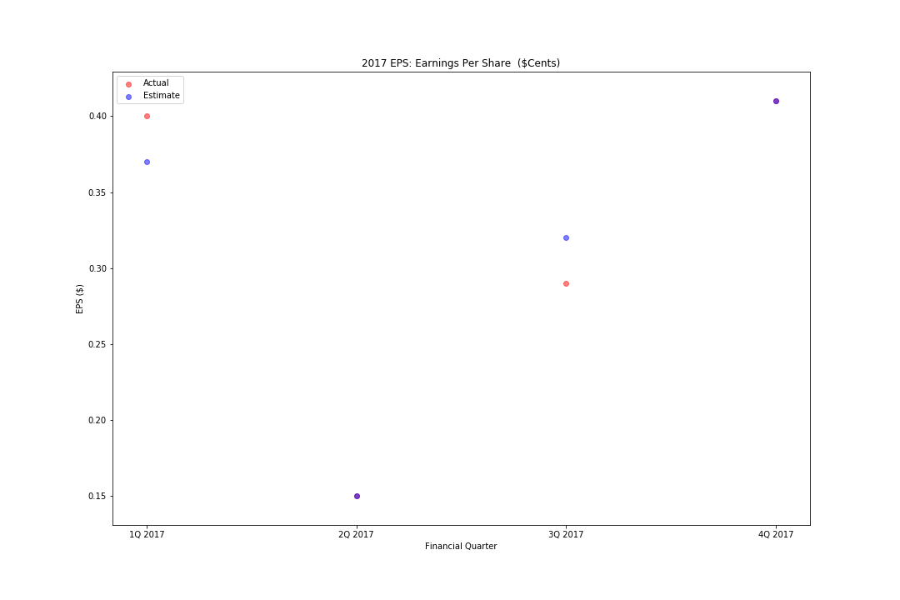
2017 EARNINGS PER SHARE (EPS)
Earnings per share (EPS) estimates were spot on in both Q2 and Q4 with actual earnings beating forecasts in Q1 and slightly underperforming forecasts in Q3. Overall earnings per share appear to be in line with analyst expectations. Q3 may be worth a closer look as under performance and the increased price volatility could indicate a significant strategic shift, an event (regulatory policy, legal event) or broader industry change (e.g. appearance of competitor).

Slide 6
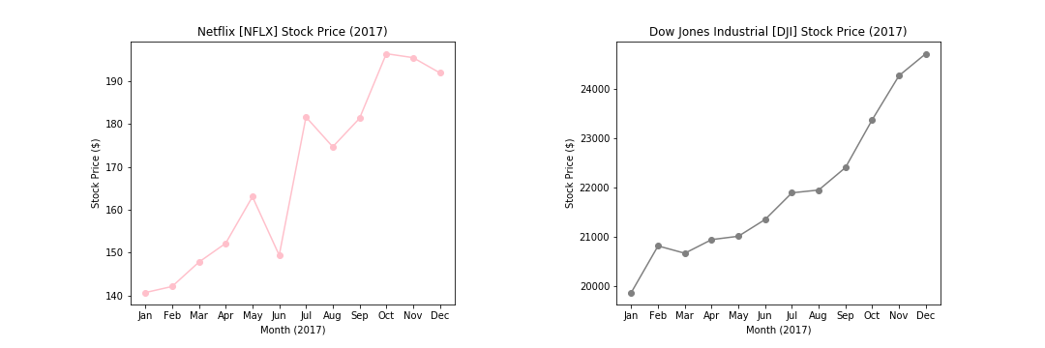
count 12.000000
mean 168.079169
std 21.298918
min 140.710007
25% 149.010003
50% 168.890007
75% 184.235005
max 196.429993
count 12.000000
mean 21937.621745
std 1503.771517
min 19864.089844
25% 20908.442383
50% 21620.375000
75% 22648.127441
max 24719.220703
36.42
NETFLIX [NFLX] & DOW JONES INDUSTRIAL [DJI] COMPARISON
Netflix [NFLX] returned a total of 36.42% over the 2017 period while the Dow Jones Industrial [DJI] returned 24.44% over the same period. Netflix outperformed the index by approximately 12%. Further evaluation of Netflix should involve calculating the price movement sensitivity (beta) against major indices to approximate drawdown risk.

